Slide 1
OSCE Answer 6/2016
TMH AED

Slide 2
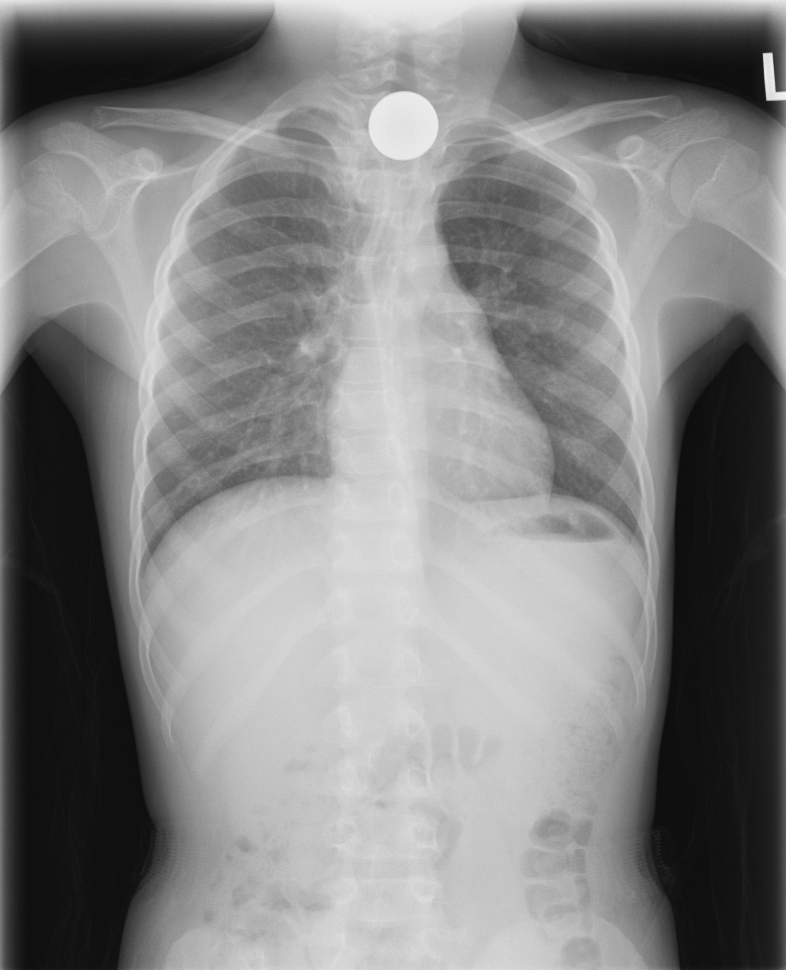
Question 1
A 6 years old boy came for ingesting a coin while playing one hour ago

Slide 3
Question 1
Where is the coin located? Trachea or esophagus?
Esophagus
Typical orientation of foreign body in:
Esophagus: coronal
Trachea: sagittal

Slide 4
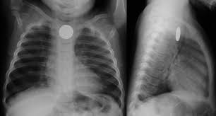
In esophagus

Slide 5
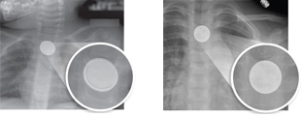
Question 1
What typical sign would there be if it is a button battery?
Halo sign
Button battery
Coin

Slide 6
Question 1
What are the potential complications if the coin is left for prolonged period of time?
Perforation
Mediastinitis etc
Fistula
Aorto-esophageal / tracheo-esophageal fistula
Bleeding
Esophageal stenosis

Slide 7
Question 1
What is your management for the child?
Coin
Admit for removal by OGD
If parent refuses admission, then re-take X ray 24 hours later
Still dislodged → Removal by OGD
c.f. Battery
Urgent removal by OGD
Risk of mucosal necrosis by local current

Slide 8
Question 2
46 years old gentlemen came for bilateral weakness for two hours. There was no history of injury, and there was no fever, back pain or limb numbness.
On physical examination, he has GCS 15/15 with stable vital signs; limb power was 1/5 over bilateral lower limbs.

Slide 9
Question 2
Please state three differential diagnoses.
Guillain-Barre Syndrome
Myasthenic crisis
Thyrotoxic Periodic Paralysis
Botulism

Slide 10
Question 2
What is the POCT that can help differentiating the diagnosis?
Blood x electrolyte level (POCT)

Slide 11
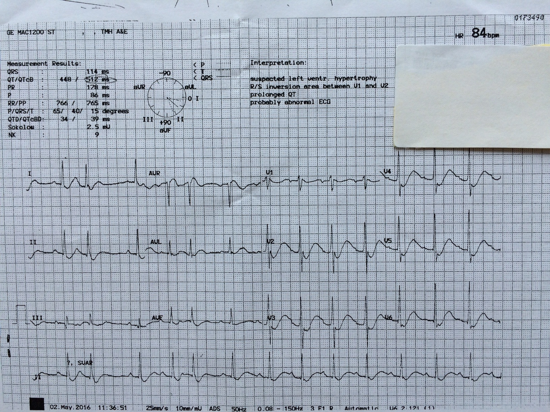
Question 2
Please describe the ECG:

Slide 12
Question 2
Sinus rhythm with U wave best seen at leads V2-3 with prolonged QTc interval.
ECG Changes associated with severe hypokalemia
Increased amplitude and width of the P wave
Prolongation of the PR interval
T wave flattening and inversion
ST depression
Prominent U waves (best seen in precordial leads)
Apparent long QT interval due to fusion of the T and U waves (= long QU interval)

Slide 13
Question 2
What is the most likely diagnosis?
Thyrotoxic periodic paralysis
Precipitating factors:
Ingestion of high carbohydrate diet
Trauma
Infection
Stress

Slide 14
Question 2
What is the management for patient?
Potassium replacement
Correction of underlying hyperthyroid state
Precaution: Too aggressive potassium replacement would lead to rebound of hyperkalemia

Slide 15
Question 3
A 54 years old gentlemen attended AED for difficulty in breathing and sore throat for two days.
On physical examination, you noted that he had fever and stridor on auscultation.

Slide 16
Question 3
Please list five causes of upper airway obstruction in adult.
Infection
Acute epiglottitis
Retropharyngeal abscess
Bacterial tracheitis
Foreign body ingestion

Slide 17
Question 3 (cont’d)
Immune
Angioedema
Anaphylaxis
Trauma
Tumor
Poisoning
Smoke inhalation
Caustic ingestion

Slide 18
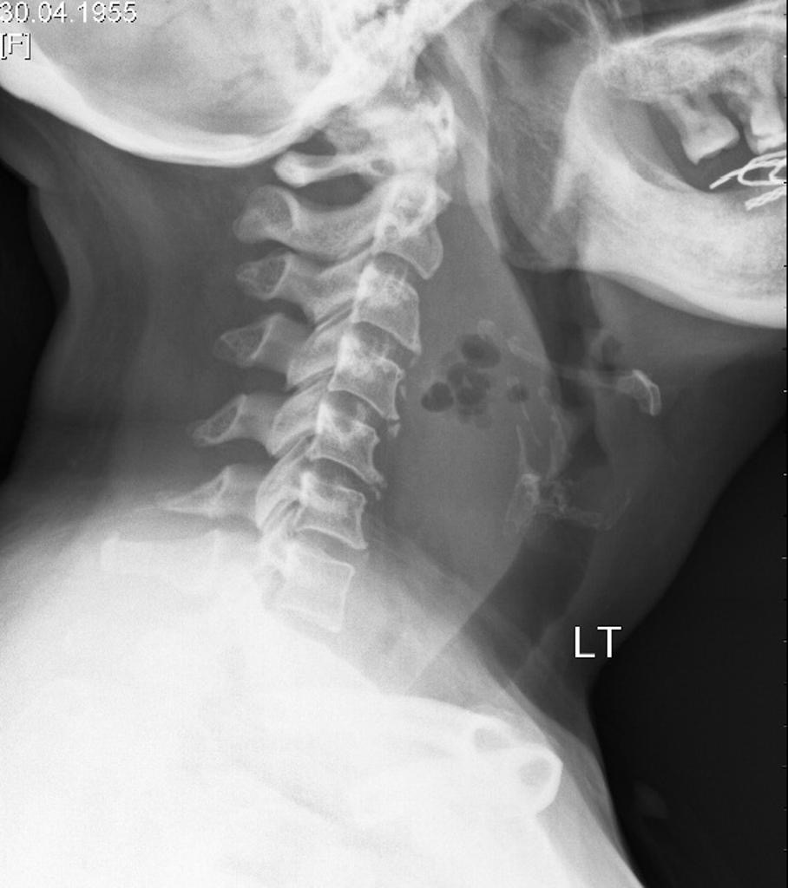
Question 3
Please describe the X-ray:

Slide 19
Question 3
Mnemonics AABCDS
Adequacy
Alignment
Bone
Cartilage
Disc
Soft tissue

Slide 20
Question 3
Significant pre-vertebral soft tissue swelling with air-pockets at C3/C4 level

Slide 21
Question 3
What is your diagnosis?
Retropharyngeal abscess

Slide 22
Question 3
What is the likely cause of this condition?
Infective cause, likely from odontogenic spread
Aerobic organisms e.g. Staphylococcus aureus
Anerobic organisms e.g. Bacteroides
Gram negative organisms e.g. Hemophilus parainfluenzae

Slide 23
Question 3
What is your management?
Contrast CT scan of neck + thorax
Broad spectrum intravenous antibiotics
Incision and drainage of the abscess

Slide 24
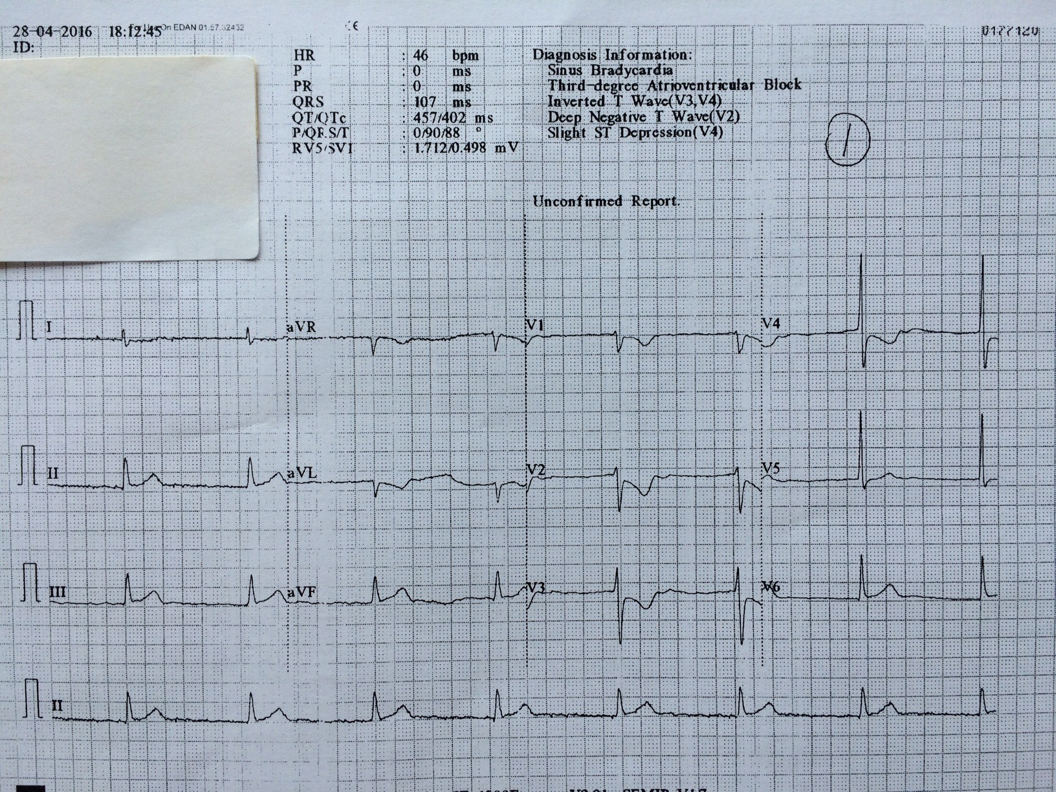
Question 4
82 years old gentlemen attended for dull chest pain for one hour. PMH: HT, DM, AF. BP 107/56mmHg, P 50/min, SpO2 97% on RA.

Slide 25
Question 4
Please describe the ECG.
ST elevation at inferior leads with reciprocal ST depression at leads aVL and V2-4
Likely represent inferior MI
Additional ECG to do:
R side ECG
Posterior lead ECG

Slide 26
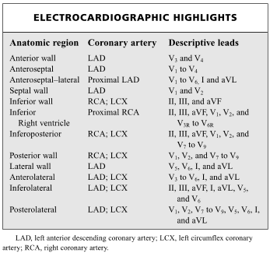

Slide 27
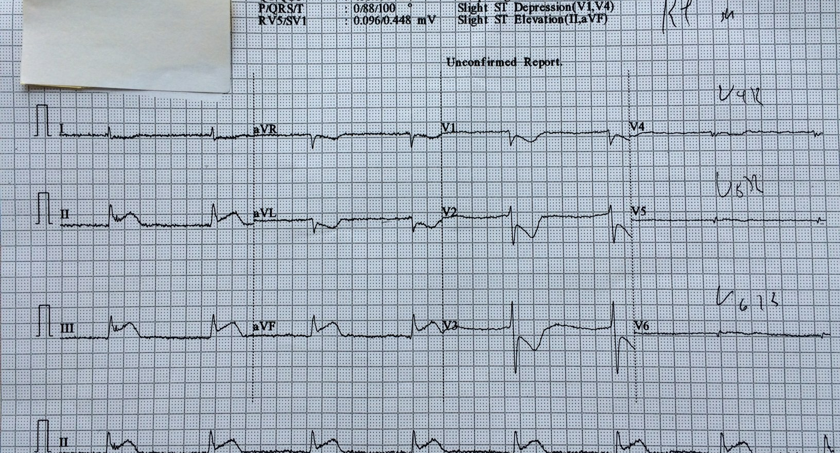
Additional ECG

Slide 28
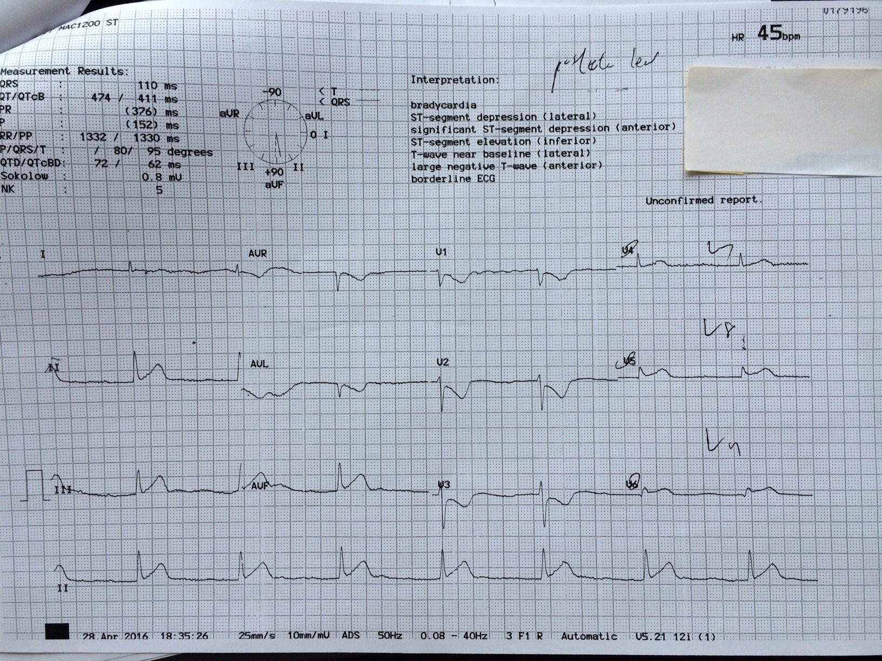

Slide 29
Question 4
What is the diagnosis?
Acute myocardial infarction involving posteroinferior wall of myocardium

Slide 30
Question 4
Please name two most important treatments for the patient.
Dual anti-platelet agents
Cardiac reperfusion therapy (Thrombolytics therapy or PCI)

Slide 31
Question 5
22 years old gentlemen with history of adjustment disorder and epilepsy, attended for suicidal attempt with drug overdose with 100 tabs of 200mg sodium valproate one hour ago.
At triage, GCS was E3V5M6, BP 153/77mmHg, P 125/min.

Slide 32
Question 5
What GI decontamination would you consider?
Activated charcoal 1g/kg PO
Gastric lavage
MDAC
WBI

Slide 33
MDAC has proven efficacy in: ABCDEQ
A Aspirin, aminophylline (=theophylline)
B Barbiturate
C Carbamazepine
D Dapsone, dilantin, digoxin
E Epilim, extended release preparation
Q Quinine

Slide 34
Question 5
What specific blood tests can be carried out?
Blood VPA level
The peak VPA level correlated with the clinical toxicity
The peak level varies with a mean of ~8 hours post exposure
>450mg/L <-> more severe manifestations
>850mg/L <-> coma, depression, aspiration, metabolic acidosis
Blood ammonia level
Acute overdose or therapeutic exposure with hepatotoxicity or encephalopathy

Slide 35
Question 5
Is there antidote? When should we consider to give?
L-carnitine
To treat VPA induced hyperammonemia, encephalopathy and hepatotoxicity

Slide 36
Question 5
Suggest one way for enhanced elimination.
Hemodialysis
Clinically severe, e.g. coma, respiratory depression
VPA level is high (usually >850mg/L)
Not responsive to intensive supportive measures

Slide 37
Question 5
(cont’d) What are the other poisonings that this method is also useful?
Methanol, Ethylene Glycol, Ethanol
Lithium
Aspirin
Isopropanol
Aminoglycosides

Slide 38
The End

